Slide 1
Bisecting an angle
Constructions

Slide 2
how to use Oak lessons

Slide 3
I can use the properties of a rhombus to construct an angle bisector.

Slide 4
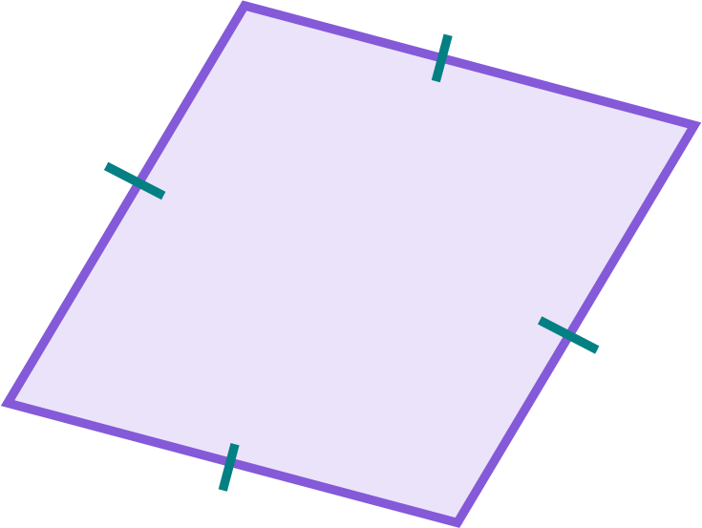
To bisect means to cut or divide an object into two equal parts.
A rhombus is a parallelogram where all sides are the same length.
If one shape can fit exactly on top of another using rotation, reflection or translation, then the shapes are congruent.

Slide 5

Bisecting an angle
Constructing a rhombus from an angle
Efficient construction of a rhombus
Bisecting an angle using rhombi constructions

Slide 6
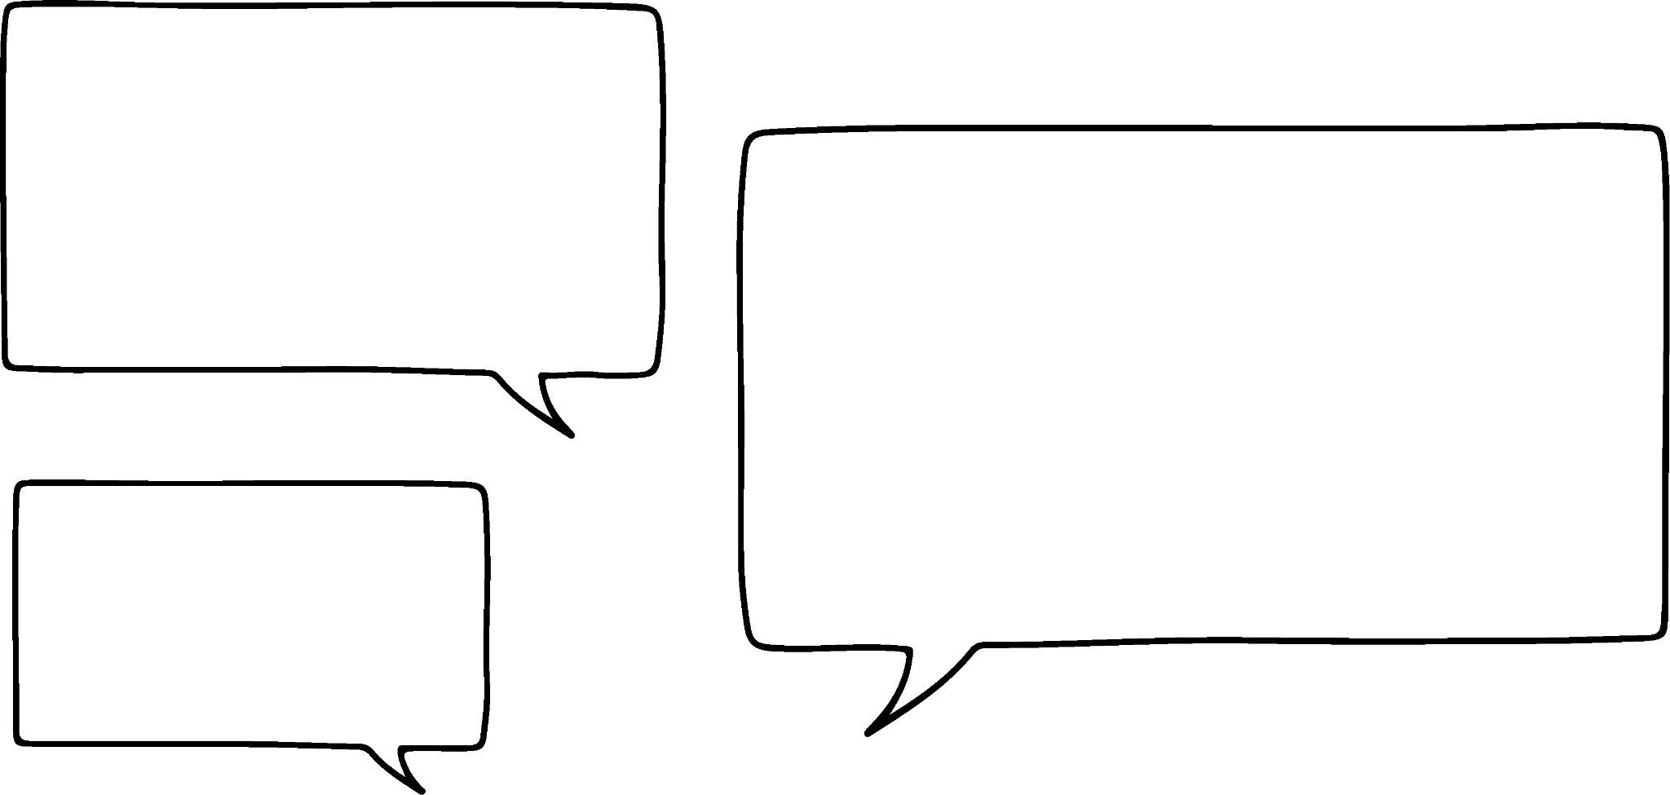
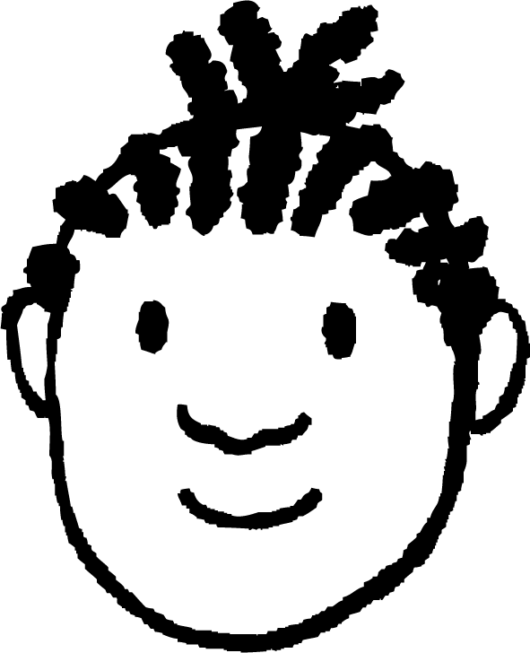

Constructing a rhombus from an angle
It’s impossible to construct a rhombus from this, as the two legs of the angle are different lengths!
Oh, we can just use a ruler to extend the shorter line! Make them both the same length!
Jacob
56°
Oh, it’s possible! We just need to figure out a way to make the two legs of the angle the same length!
Lucas

Slide 7
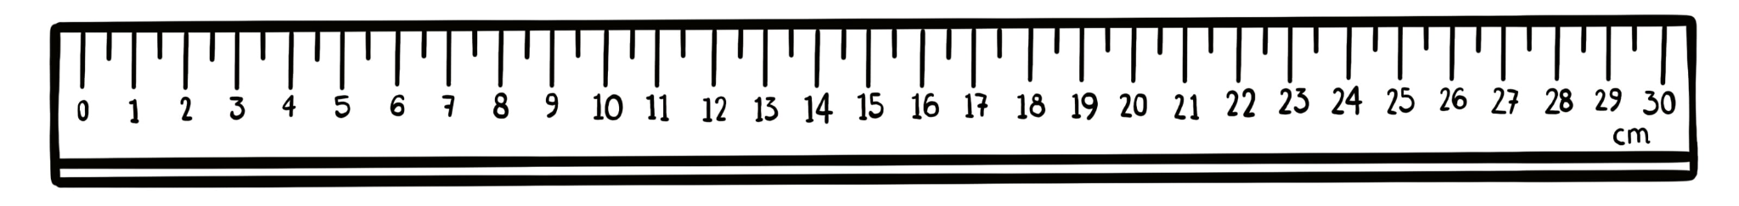
Constructing a rhombus from an angle
Some lengths are really tricky to measure precisely using a ruler!
56°
I don’t think I drew it the same length. This won’t become a rhombus!
Oh no, exactly how many millimetres is that?

Slide 8
Constructing a rhombus from an angle
It’s impossible to construct a rhombus from this, as the two legs of the angle are different lengths!
Maybe we can use a pair of compasses to make both legs of the angle the same length.
Jacob
56°
I guess so. Doesn’t a circle have the same radius all around its centre? Maybe that’ll help!
Lucas

Slide 9
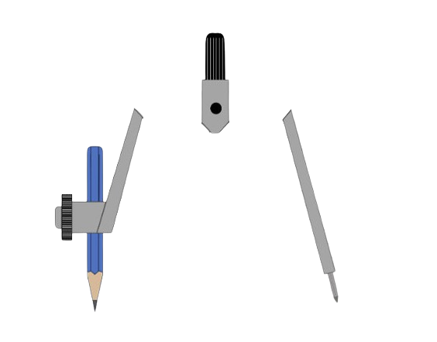
Constructing a rhombus from an angle
We can place the compass needle on the vertex of the angle,
set its length to less than the shortest leg of the angle,
and draw a full circle.
Oh yeah! If you look at the part of each leg inside the circle… They’re both the same length!
56°
Lucas

Slide 10
Constructing a rhombus from an angle
But what if we made the length of the compasses larger? Would this still work?
Lucas
56°
If you make the pair of compasses too wide, the circle will be too big to fit the whole line segment!

Slide 11
Constructing a rhombus from an angle
So, you can make the width of the pair of compasses smaller than the legs of the angle.
Jacob
But you definitely can’t make it larger than either of them!
56°

Slide 12
Constructing a rhombus from an angle
I guess it’s safe to make the pair of compasses as wide as the shorter leg, if it can reach that far.
Lucas
56°

Slide 13
Constructing a rhombus from an angle
The parts of the legs inside the circle are the two sides of the rhombus…
Lucas
56°
So, we can just ignore the useless part of the leg that’s outside the circle.

Slide 14
Constructing a rhombus from an angle
Just like before:
place the compass needle on the open endpoint of a leg
place the pencil on the vertex of the angle
draw a circle
repeat on the open endpoint of the other leg
56°
part of the original leg of the angle that isn’t included in the final rhombus

Slide 15
Constructing a rhombus from an angle
With a ruler, draw any two lines of slightly different lengths.
Create a rhombus from these two lines.
With a ruler, draw any two lines of slightly different lengths.
Create a rhombus from these two lines.
Try it yourself.
This can be any pair of lines.

Slide 16
Constructing a rhombus from an angle
Place the compass needle on the vertex of the angle,
With a ruler, draw any two lines of slightly different lengths.
Create a rhombus from these two lines.
and the pencil on the open endpoint of the shorter leg of the angle.
Draw a full circle.
Try it yourself.
this part of the leg will not be included in the rhombus

Slide 17
Constructing a rhombus from an angle
Draw two more circles.
Each one has the compass needle on an open endpoint of the rhombus (inside the first circle drawn), and the pencil on the vertex of the angle.
With a ruler, draw any two lines of slightly different lengths.
Create a rhombus from these two lines.
Try it yourself.

Slide 18
Constructing a rhombus from an angle
Find the point where the last two circles drawn intersect.
With a ruler, draw any two lines of slightly different lengths.
Create a rhombus from these two lines.
This is the final vertex of the rhombus.
Join the vertices together to complete the rhombus.
Try it yourself.

Slide 19
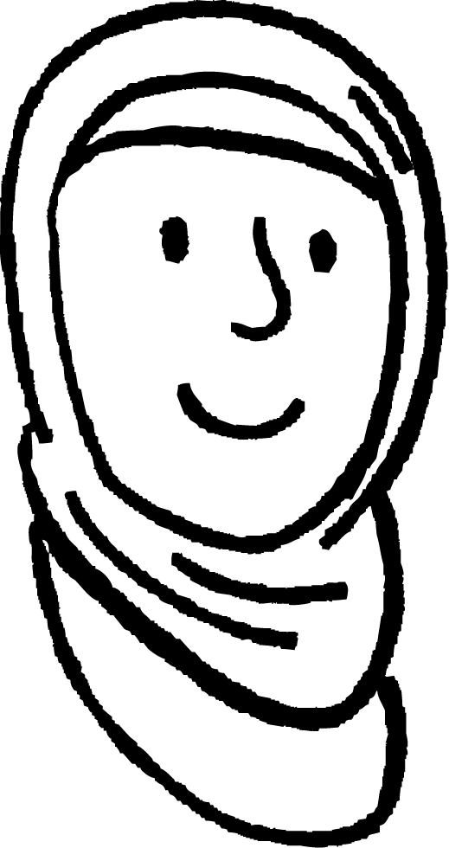

Constructing a rhombus from an angle
Aisha begins construction of a rhombus from this angle.
Aisha
Which point is the final vertex of the rhombus?
B
C
A

Slide 20
Constructing a rhombus from an angle
What is the maximum radius of each circle in the construction of this rhombus?
12 cm
The maximum radius of each circle should be the length of the shorter leg of the angle.
Any radius smaller than this is possible - whatever works for the length of your pair of compasses.
18.6 cm
12 cm

Slide 21
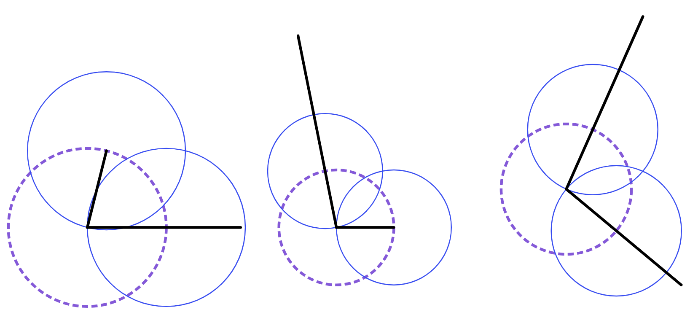
Constructing a rhombus from an angle
1) Complete each construction to draw a rhombus.
rhombus B
rhombus C
rhombus A

Slide 22
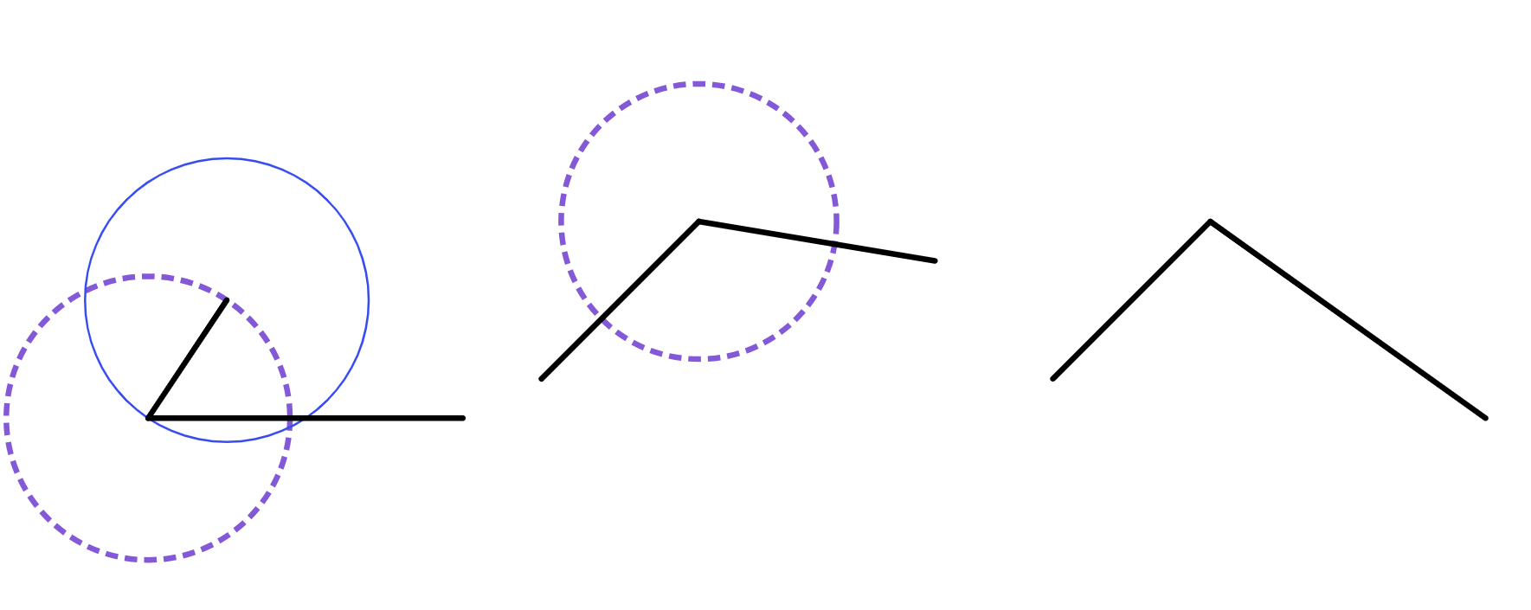
Constructing a rhombus from an angle
2) Complete each construction to draw a rhombus.
rhombus B
rhombus C
rhombus A

Slide 23
Constructing a rhombus from an angle
1) Complete each construction to draw a rhombus.
rhombus B
rhombus C
rhombus A

Slide 24
Constructing a rhombus from an angle
2) Complete each construction to draw a rhombus.
rhombus B
rhombus C
rhombus A
Using a protractor, measure the opposite angles of each rhombus.
If each pair of opposite angles are the same size, then your construction is accurate!

Slide 25
Bisecting an angle
Constructing a rhombus from an angle
Efficient construction of a rhombus
Bisecting an angle using rhombi constructions

Slide 26
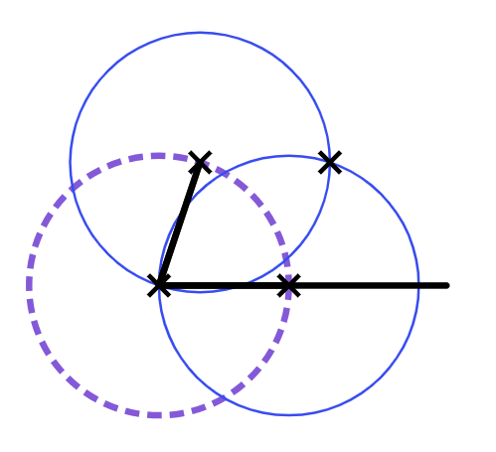
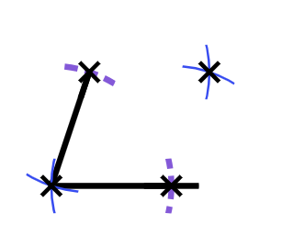
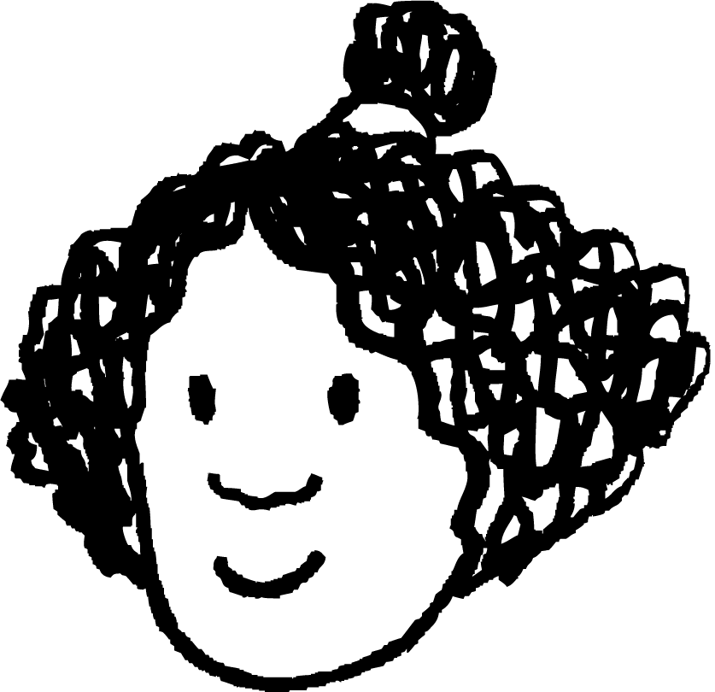

Efficient construction of a rhombus
These constructions look really confusing and take up a lot of space!
Is there a better way to construct a rhombus?
Izzy
I don’t think you need to draw every circle fully, since we only care about a couple of points on each circle.
Sam

Slide 27
Efficient construction of a rhombus
It is possible to accurately construct a rhombus by drawing the arcs of a circle. We draw the arc if the circle will intersect a line segment or another circle.
In total, only four circular arcs would need to be drawn for any rhombus.

Slide 28
Efficient construction of a rhombus
With a ruler, draw any two lines of slightly different lengths.
Create a rhombus from these two lines by only constructing circular arcs.
With a ruler, draw any two lines of slightly different lengths.
Create a rhombus from these two lines by only constructing circular arcs.
Try it yourself.

Slide 29
Efficient construction of a rhombus
Place the compass needle on the vertex of the angle,
With a ruler, draw any two lines of slightly different lengths.
Create a rhombus from these two lines by only constructing circular arcs.
and set it to any sensible length shorter than the shorter leg.

Slide 30
Efficient construction of a rhombus
Keeping the needle in place, use the pencil to draw small arcs in the area where the pencil overlaps the two legs of the angle.
With a ruler, draw any two lines of slightly different lengths.
Create a rhombus from these two lines by only constructing circular arcs.
Try it yourself.

Slide 31
Efficient construction of a rhombus
Each intersection is a vertex of the rhombus.
Keep the compass at the same length (or reset the compass size by placing the compass needle on the intersection, and the pencil on the vertex of the angle.)
With a ruler, draw any two lines of slightly different lengths.
Create a rhombus from these two lines by only constructing circular arcs.

Slide 32
Efficient construction of a rhombus
With the compass needle on one of the intersections you just drew, create an arc in this general area.
We expect the final arc to intersect the second one somewhere in this space.
With a ruler, draw any two lines of slightly different lengths.
Create a rhombus from these two lines by only constructing circular arcs.
Try it yourself.

Slide 33
Efficient construction of a rhombus
Put the compass needle on the other intersection you drew, and create a third arc that intersects the second one.
With a ruler, draw any two lines of slightly different lengths.
Create a rhombus from these two lines by only constructing circular arcs.
Try it yourself.

Slide 34
Efficient construction of a rhombus
If your two arcs don’t intersect, then go back and make the arcs a bit longer until they do.
With a ruler, draw any two lines of slightly different lengths.
Create a rhombus from these two lines by only constructing circular arcs.

Slide 35
Efficient construction of a rhombus
Where the two arcs intersect is the final vertex of the rhombus.
Join this vertex to the two open endpoints to complete the rhombus.
With a ruler, draw any two lines of slightly different lengths.
Create a rhombus from these two lines by only constructing circular arcs.
Try it yourself.

Slide 36

Efficient construction of a rhombus
In this nearly completed construction, which arcs were the first to be drawn?
b
a
d
c

Slide 37
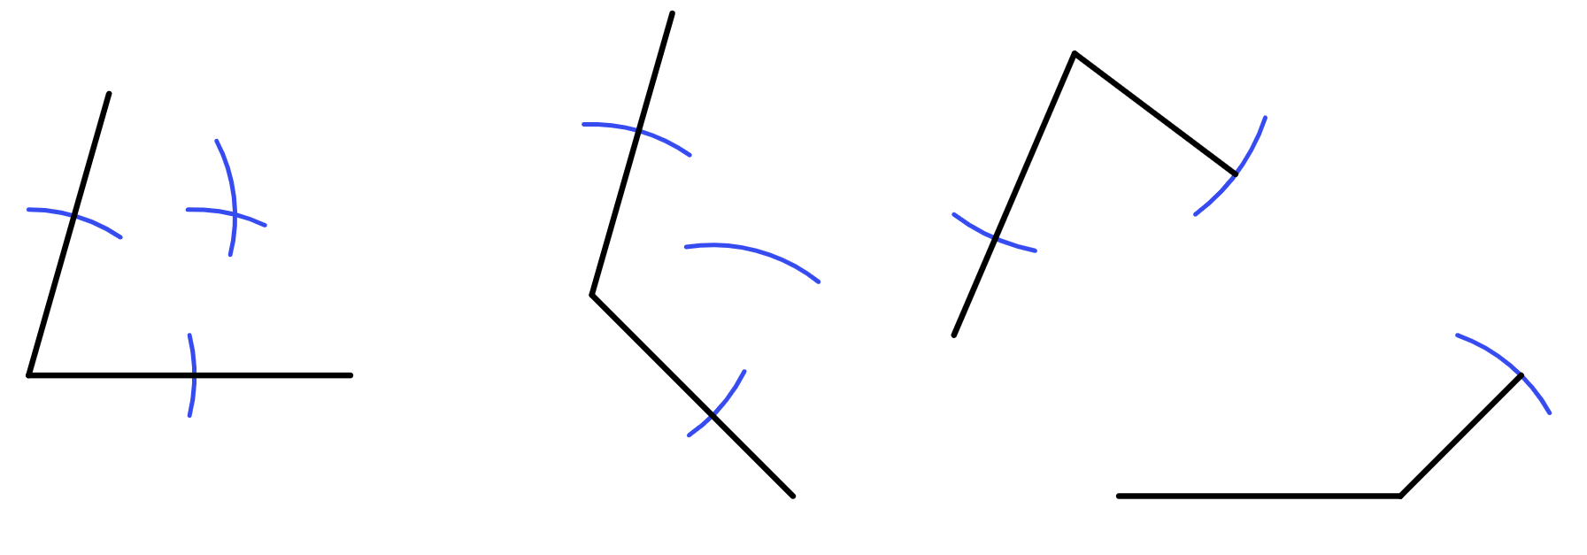
Efficient construction of a rhombus
1) By only drawing arcs and straight lines, complete the construction of each rhombus.
rhombus B
rhombus C
rhombus A
rhombus D

Slide 38
Efficient construction of a rhombus
1) By only drawing arcs and straight lines, complete the construction of each rhombus.
rhombus B
rhombus C
rhombus A
rhombus D

Slide 39
Bisecting an angle
Constructing a rhombus from an angle
Efficient construction of a rhombus
Bisecting an angle using rhombi constructions

Slide 40

Bisecting an angle using rhombi constructions
I get how to construct a rhombus now.
But I still don’t understand why it’s helpful!
70°
35°
Laura
The diagonals of a rhombus intersect at right angles.
If a diagonal is drawn, the interior angle of a rhombus is halved:
the angle is bisected.

Slide 41
Bisecting an angle using rhombi constructions
This quadrilateral is a rhombus.
Its diagonals are drawn.
Calculate the values of angles a, b, and, c.
b°
a°
c°
a = 62°
b = 28°
c = 90°
124°
56°

Slide 42
Bisecting an angle using rhombi constructions
Bisect this angle.
A bisected angle will cut the angle exactly in half.
To bisect any angle, we can construct a rhombus, then draw on its diagonal.
We follow the same method as before.
84°
42°

Slide 43
Bisecting an angle using rhombi constructions
Bisect this angle.
Step 1: Set the pair of compasses at any width shorter than the two legs.
Step 2: Construct a rhombus from four circular arcs.
84°

Slide 44
Bisecting an angle using rhombi constructions
Bisect this angle.
Step 3: Draw the two sides of the rhombus and draw on its diagonal.
84°
42°

Slide 45
Bisecting an angle using rhombi constructions
Bisect this angle.
Alternative step 3:
It’s not even necessary to construct the full rhombus.
As long as you draw a line from the point where the two arcs intersect to the vertex of the angle, you will bisect that angle.
84°
42°

Slide 46
Bisecting an angle using rhombi constructions
Aisha begins construction of a rhombus to bisect this angle of 78°.
Which of these could be a sensible next step in Aisha’s construction?
a
Set the length of the compass by placing the needle on the intersection and the pencil on the vertex of the angle.
Aisha
b
Drawing the diagonal of the rhombus to bisect the angle.
c
Draw another arc with the compass needle placed on the intersection Aisha already drew.
78°

Slide 47
Bisecting an angle using rhombi constructions
Aisha begins construction of a rhombus to bisect this angle of 78°.
Which of these could be a sensible next step in Aisha’s construction?
a
Set the length of the compass by placing the needle on the intersection and the pencil on the vertex of the angle.
Aisha
If in doubt, it’s always good to reset the length of your pair of compasses so that the construction continues to make a rhombus.
78°

Slide 48
Bisecting an angle using rhombi constructions
Sam only wanted to bisect the 78° angle.
Which of these construction lines didn’t need to be drawn?
a
The two arcs that intersect each other.
b
The diagonal that bisects the 78° angle.
c
The last two sides of the rhombus.
d
The angle marker for 39°.
39°
78°
Sam

Slide 49
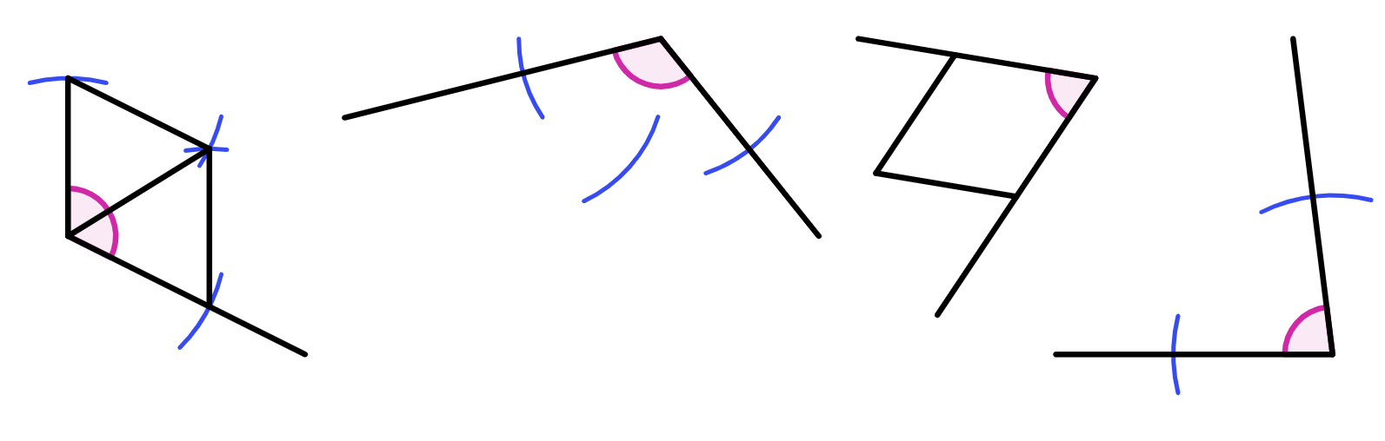
Bisecting an angle using rhombi constructions
1) These constructions show partially drawn angle bisectors.
a) Using a protractor, measure the acute or obtuse angle.
b) Complete each construction.
c) Using a protractor, measure the bisected angle and check if it is half the
original angle.
angle bisector C
angle bisector B
angle bisector A
angle bisector D

Slide 50
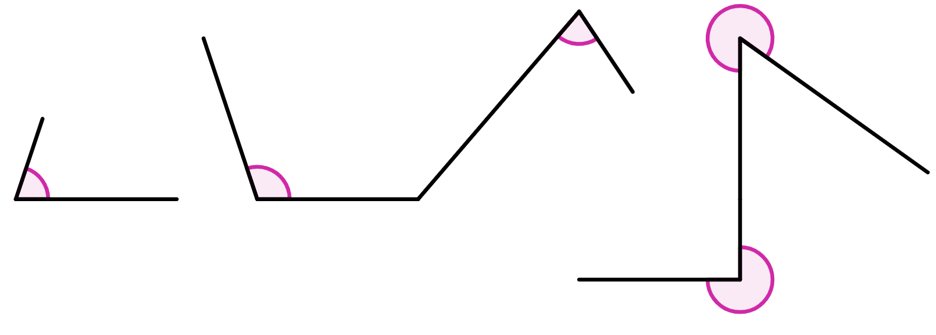
Bisecting an angle using rhombi constructions
2) Bisect each of the given angles, and measure the size of the bisected angle.
a)
b)
c)

Slide 51
Bisecting an angle using rhombi constructions
1) These constructions show partially drawn angle bisectors.
a) Using a protractor, measure the acute or obtuse angle.
b) Complete each construction.
c) Using a protractor, measure the bisected angle and check if it is half the
original angle.
angle bisector C
117° and 58.5°
66° and 33°
angle bisector B
115° and 57.5°
83° and 41.5°
angle bisector A
angle bisector D

Slide 52
Bisecting an angle using rhombi constructions
2) Bisect each of the given angles, and measure the size of the bisected angle.
bisected angle of 153°.
a)
b)
c)
bisected angle of 37°.
bisected angle of 54°.
bisected angle of 36°.
bisected angle of 135°.

Slide 53
Bisecting an angle
Knowing that rhombi have four equal side lengths makes it possible to construct a rhombus given only two of its sides.
By drawing a suitable circle with centre at the vertex of an angle, a rhombus can be constructed from any angle with any leg length.
Constructions of rhombi can be made more efficient by drawing only four arcs: two which intersect at the legs of an angle, and two which intersect each other.
The constructions involved in constructing a rhombus are helpful in bisecting an angle.

Slide 54

© Oak National Academy 2023.
Produced in partnership with Mathematics in Education and Industry.
Licensed on the Open Government Licence v3.0, except where otherwise stated. See Oak terms and conditions.

